Slide 1
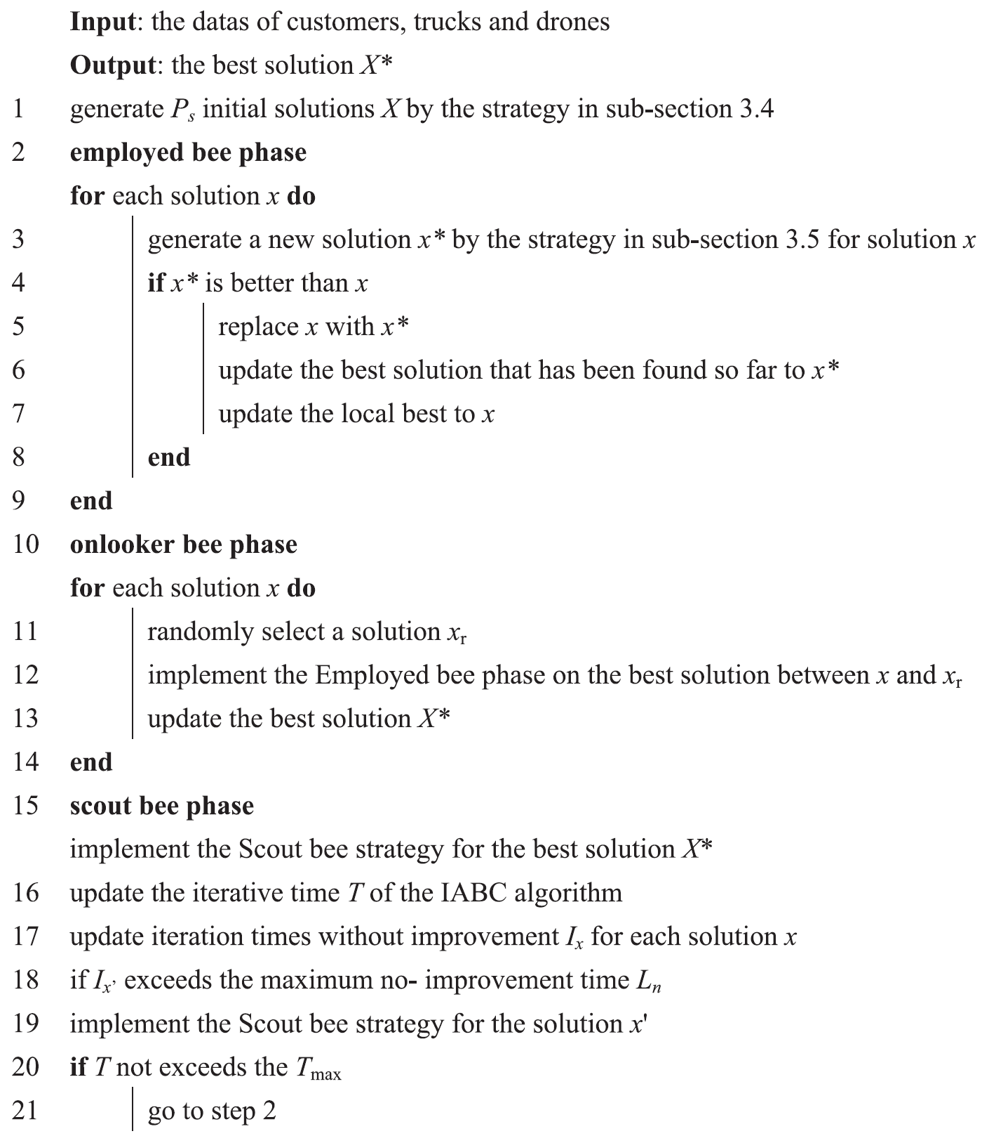
The Improved Artificial Bee Colony algorithm
The Repair Strategy replaces infeasible solution with feasible ones.
The traditional employed bee strategy chooses customers randomly of certain route, then re-arrange these customers to other routes.
Easy to accomplish but hard to reach to an improved solution.
Thus, use Enhanced employed bee strategy which chooses customers not randomly but based on Push Forward Insertion Heuristic (PFIH)
The Scout bee strategy makes large changes to the solution.
Executes a local search to insert some customers of solution
Replace the truck of this solution with another new one.

Slide 2
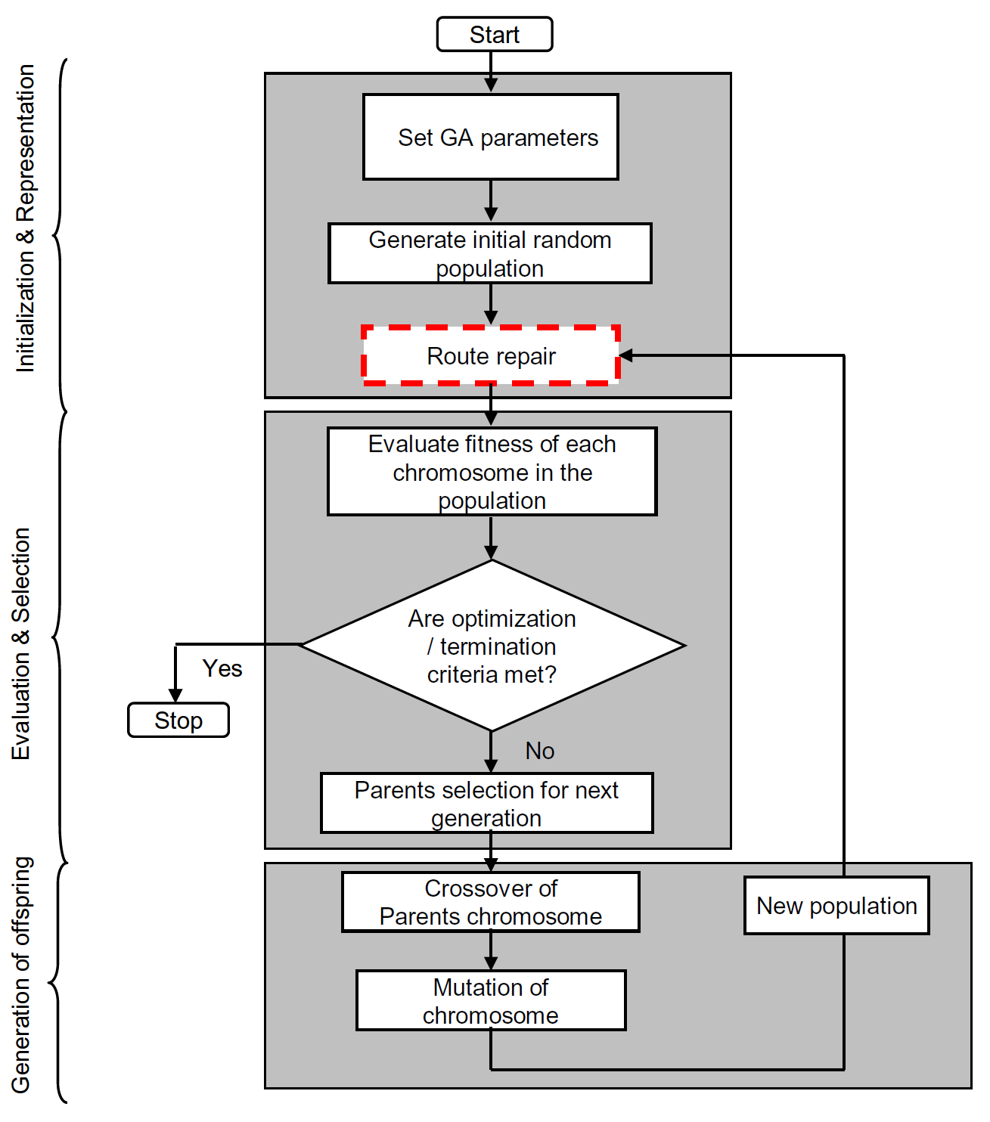
Genetic New algorithm
A random permutation method is used to generate initial solution.
If the solution meets the precedence constraints fitness value is noted.
If the solution does not meet the precedence constraints, then crossover takes place

